Slide 1
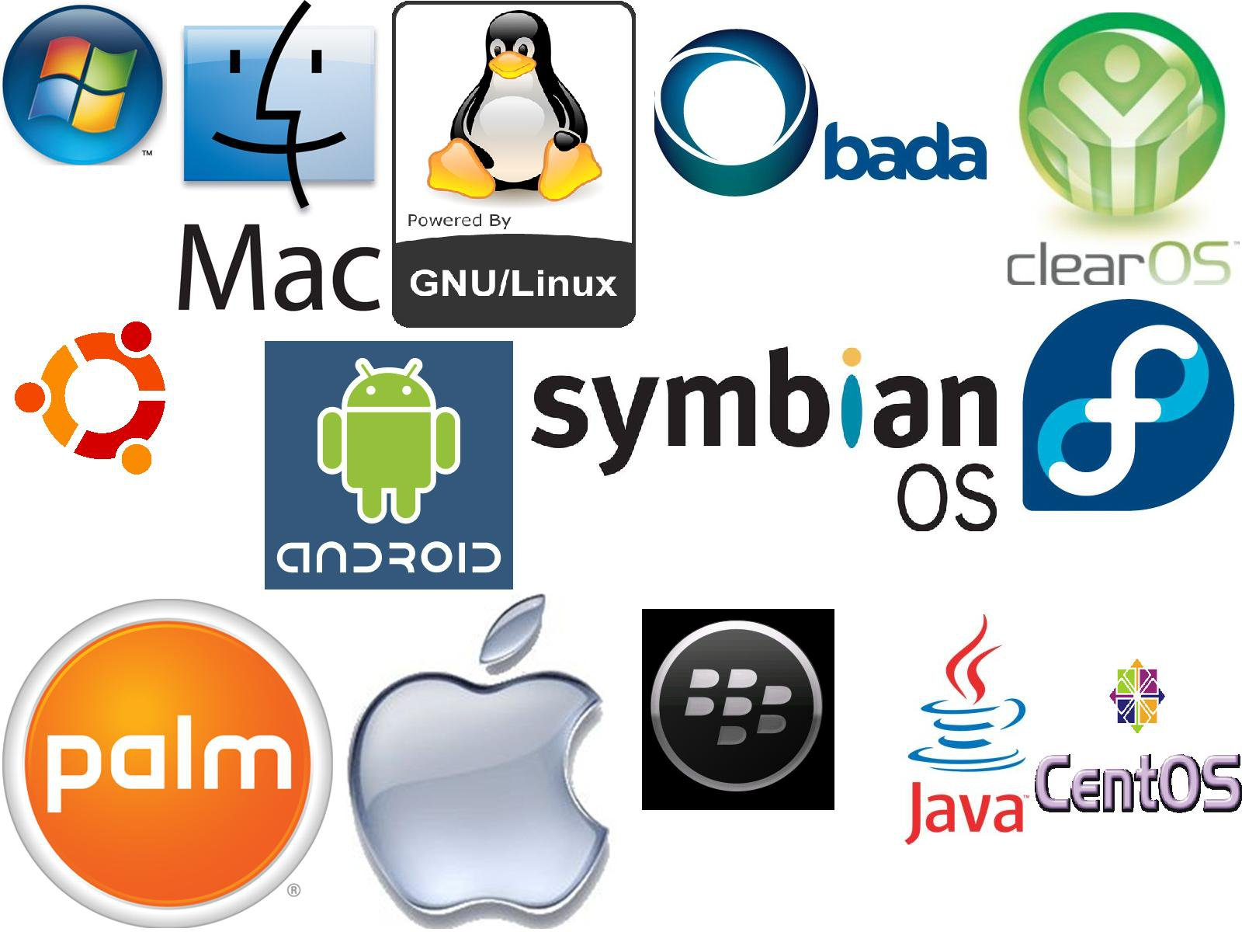
Real time operating system
Er. Deeyoranjan Dongol

Slide 2
REAL TIME OPERATING SYSTEM [RTOS]
Special-purpose operating system used in computers that has strict time constraints for any job to be performed
Employed mostly in those systems in which the results of the computations are used to influence a process while it is executing
Examples: MTS, Lynx, QNX, VxWorks

Slide 3
APPLICATIONS OF RTOS
Real-time running structures are used inside the Radar gadget
Real-time running structures are utilized in Missile guidance
Real-time running structures are utilized in on line inventory trading
Real-time running structures are used inside the cell phone switching gadget
Real-time running structures are used in Medical Imaging Systems
Real-time running structures are utilized in Autopilot travel simulators

Slide 4
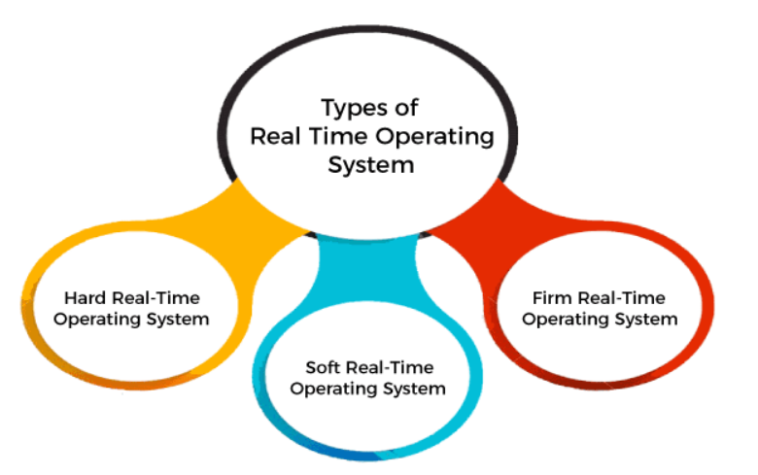
TYPES OF RTOS
Notes:
Note that a request edge points to only the rectangle R1, whereas an assignment edge must also designate one of the dots in the rectangle.

Slide 5
HARD REAL TIME OPERATING SYSTEM
All critical tasks must be completed within the specified time duration, i.e., within the given deadline
Not meeting the deadline would result in critical failures such as damage to equipment or even loss of human life
Example
Airbags provided by carmakers along with a handle in the driver's seat
When the driver applies brakes at a particular instance, the airbags grow and prevent the driver's head from hitting the handle
Had there been some delay even of milliseconds, then it would have resulted in an accident

Slide 6
SOFT REAL TIME OPERATING SYSTEM
Accepts a few delays via the means of the Operating system
There may be a closing date assigned for a particular job, but a delay for a small amount of time is acceptable
So, cut off dates are treated softly via means of this kind of RTOS
Example
Online Transaction systems
Livestock price quotation Systems

Slide 7
FIRM REAL TIME OPERATING SYSTEM
Firm RTOS additionally want to observe the deadlines
However, lacking a closing date might not have a massive effect, however may want to purposely undesired effects, like a massive discount within the fine of a product
Example
Multimedia applications

Slide 8
ADVANTANGES OF RTOS
Easy to layout, develop and execute real-time applications under the real-time operating system
In a Real-time operating system, the maximum utilization of devices and systems
Focus on running applications and less importance to applications that are in the queue
Since the size of programs is small, RTOS can also be embedded systems like in transport and others
Memory allocation is best managed in these types of systems

Slide 9
DISADVANTANGES OF RTOS
Real-time operating systems have complicated layout principles and are very costly to develop
Real-time operating systems are very complex and can consume critical CPU cycles

